Slide 1
EU Youth Dialogue
European Steering Group Meeting
21 September 2021
Brussels

Slide 2
Agenda
Time | Programme
10:00 | Welcome & Introduction Opening speeches Tour de table : opening words and introduction of participants Adoption of Agenda
10:30 | Setting up the ESG Discussion of ESG Draft Working Document for the 9e cycle
11:45 | Exchanges with the Commission on various concrete issues related to the implementation of the cycle
12:30 | Lunch (self-payment)
14:00 | Implementation phase of the cycle / Concept note of the 9th EUYD Core Principles Thematic framework Overall architecture of the cycle Outcomes expected
16:00 | Next steps for the ESG and wrapping up Calendar of upcoming meetings List of documents to produce by the ESG
17:00 | End of the meeting

Slide 3
Motto of the 9th cycle of the EU Youth Dialogue
“Engaging together for a sustainable and inclusive Europe”

Slide 4
Welcome and Introduction
Opening speeches
Tour de table : opening word and introduction of participants
Adoption of Agenda

Slide 5
Setting-up the ESG ESG Draft Working Document
EU Youth Dialogue ESG Trio presidency Working Document (Based on the structure of the previous cycle) :
Co-chairs
Secretariat
Membership
Operational tasks of the European Steering Group
Functions and specific tasks in the European Steering Group
Financing
Working methods : Meetings, Communication

Slide 6
Working within the ESG (1)
Co-chairs :
Ministries / authorities ;
And
National Youth Council of the acting presidency.
Secretariat :
European Youth Forum (to be confirmed by the Forum).

Slide 7
Working within the ESG (2)
Membership : 2 representatives of each of the following institutions/organisations :
Trio presidency ministries / authorities, or bodies nominated by the ministries/authorities responsible for youth affairs ;
Trio presidency National Youth Councils ;
The European Commission ;
The European Youth Forum.

Slide 8
Working within the ESG (3)
In addition, the ESG is including:
Two external experts : one with expertise on the EU Youth Dialogue, one with expertise on “inclusion” and “sustainable development” ;
Two facilitators who will be in charge of facilitating the three European Youth Conferences ;
Guests, as needed, by consensus of ESG.

Slide 9
Working within the ESG (4)
Operational tasks of the ESG:
decides, coordinates and monitors the implementation of the EUYD
provides overall guidance and support to the EUYD;
cooperates with the National Working Groups.
defines a communication strategy and organises a webinar for the NWG and INGYO to coordinate the implementation of the cycle ;
ensures participatory evaluation of the cycle;
communicates and disseminates the results of the EUYD;
transmits knowledge to the next to the following ESG;
gives visibility and provides information about the EUYD;
implements the outcomes of the meetings of the European Steering Group with regard to the EUYD.

Slide 10
Working within the ESG (5)
Functions and specific tasks in the European Steering Group :
Shared responsibilities of all members (same as the 8th cycle)

Slide 11
Working within the ESG (6)
Functions and specific tasks in the European Steering Group :
The Co-chairs ;
The Secretariat of the European Steering Group ;
The Presidency/Trio Presidency ;
The European Commission ;
The European Youth Forum ;
National Youth Councils.
We will need to add the function of facilitators and experts, based on the call for identifying them.

Slide 12
Working within the ESG (7)
Financing :
Costs of the ESG members and their tasks covered by the bodies or organisations represented by the ESG members ;
Costs of external experts and facilitators necessary services will be covered by the national authorities of the trio presidency, funding allowing (need to be discussed);
Meeting costs will be covered by the hosting body.
Working methods :
Meetings ;
Communication : global communication strategy, online depository.

Slide 13
Exchange with the European Commission
About various concrete issues related to the implementation of the cycle ;
Questions about fundings for the presidency ;
Question about the EU political agenda ;
Question about the architecture of the cycle.

Slide 14
Implementation phase of the cycle / Concept note of the 9th EUYD
Core Principles ;
Thematic framework ;
Overall architecture of the cycle ;
Outcomes expected.

Slide 15
Core Principles
Cooperation ;
Youth Lead Process ;
Impact ;
Sustainability and inclusion.

Slide 16
Thematic framework (1/2)
Youth Goal #10 Sustainable Green Europe and Youth Goal #3 Inclusive Societies ;
Motto : “Engaging together for a sustainable and inclusive Europe”;
Two aims : “Achieving a society in which all young people are environmentally active, educated and able to make a difference in their everyday lives” and “Enabling and ensuring the inclusion of all young people in society”.

Slide 17
Thematic framework (2/2)
Climate change and the environment remain at the top on the list of priorities for young people in Europe ;
Major European Programmes have been launched recently to fight climate change and environnemental degradation ;
Global approach is key and will be collectively addressed within 18 months period of the cycle ;
Sustainable development goals cannot be achieved without involving every young person, even the ones with less opportunities, and realising their rights ;

Slide 18
Overall architecture of the cycle
Overview of the process ;
EU Youth Conferences ;
Survey and qualitative consultation and implementation phase reporting.

Slide 19
Overview of the process
3 phases and consequent steps ;
The design of the cycle :
Step 1 : acculturation/streamlining and exploration phase of the topic ;
Step 2 : Proposition on the dialogue activities and starting implementation activities;
Step 3 : Reflecting on implementation activities (where applicable continuing the implementation), feedback and planning the follow-up process

Slide 20
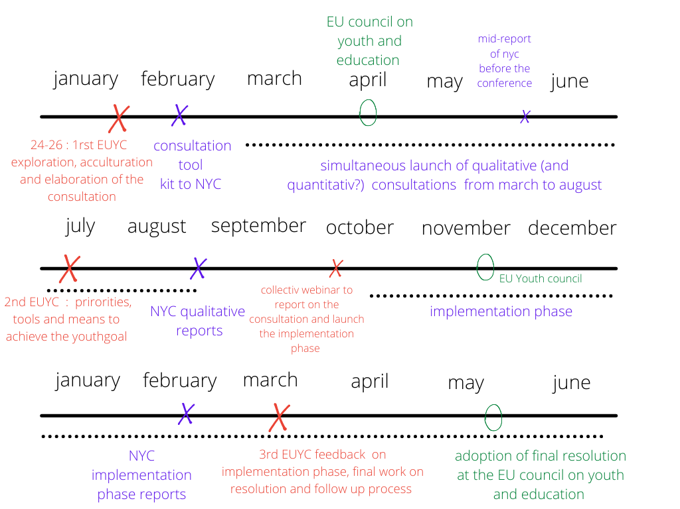
Overview of the cycle

Slide 21
EU Youth Conferences (1/2)
Upcoming events :
The first one in Strasbourg from 24 to 26 January ;
The second one in Czech Republic in July 2022 ;
The third and last one in Sweden in March 2023.

Slide 22
EU Youth Conferences (2/2)
The overall expected outputs of the three EU Youth Conferences during the 9th cycle :
contribute to shaping the dialogue process of the 9th cycle ;
channel young persons’ demands/perceptions, thoughts and ideas and feed into the Council documents of the Education, Youth, Culture and Sport Council ;
deliver young persons’ demands/perceptions, thoughts and ideas to decision-makers both at the EU-level, at local and at national level in the Member States in the form of Youth Actions on how to implement the relevant European Youth Goals ;
further develop and improve the governance and the overall implementation of the EU Youth Dialogue process.

Slide 23
Survey and qualitative consultation and implementation phase reporting
This part of the document has to be discussed.
Should the 9th cycle of the EU Youth Dialogue follow or not the same organisation as the 8th cycle for the consultation.
Suggestion to change the timeframe for the consultation period is extended to allow for more time to compile results at the national level. Suggestion that the consultation should last at least six months.
Question on whether or not having a centralized or decentralized consultation. Feedback from 8th cycle would be useful.

Slide 24
Outcomes expected
The implementation of the European Youth Goals #10 and #3 will be reflected as results of the 9th cycle in different areas and on local, regional, national and European levels :
Realising the European Youth Goals #10 and #3 : concrete proposals, actions, tools and good practices ;
Inputting in the work of the Council of the EU
Contributing to shaping political demands for identifying the problems to be resolved, as well as possible solutions and the respective ways to find possible solutions beyond the youth sector

Slide 25
Next steps for the ESG and wrapping up
Calendar of upcoming meetings ;
List of documents to produce by the ESG.

Slide 26
List of documents to produce by the ESG (1/2)
Cycle documentation :
Explanatory note EUYD ;
ESG
ESG Draft Working Document ;
Call for researcher: background information, nature of the task, competences required, application ;
Conferences
Additional Tools and Guidance For Facilitating Online Events ;
Example participant monitoring form ;
Call for facilitators ;

Slide 27
List of documents to produce by the ESG (1/2)
Guide for INGYOs Facilitating Round tables ;
Consultation :
Methodology - Participatory Action Research Methodology ;
Methodology - Participatory visual methodology ;
Reporting tool.
Implementation of the cycle
Guide For NWGs Facilitating Youth Dialogue Events ;
Others?

Slide 28
Calendar of upcoming meetings
To be discussed.
Next meeting : proposition of virtual meeting

Slide 29
End of the meeting

